Slide 1
Anthony James Clifford
The man you need to know!
Notes:
Muziek:
http://www.youtube.com/watch?v=K3PHSaIP830&feature=related

Slide 4
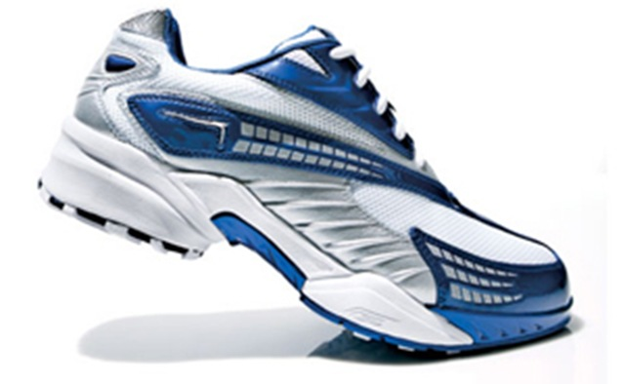

Slide 5
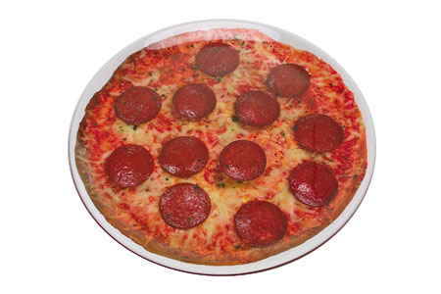

Slide 6
HOUSE

Slide 7
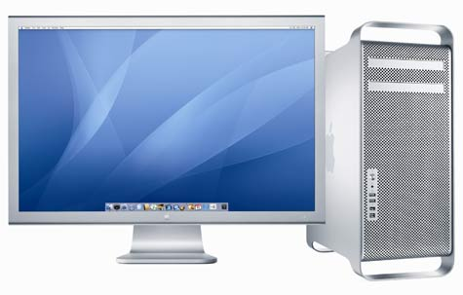
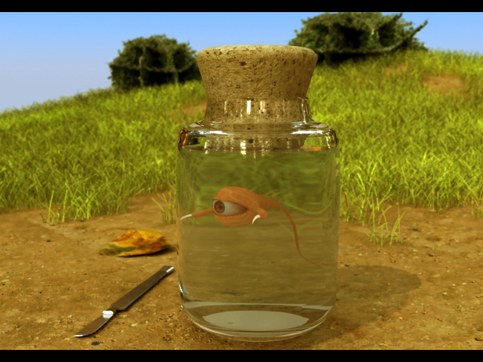

Slide 8
Altijd resultaat

